Slide 1

Planning Board
5:30 PM | April 21, 2022 | King Street Meeting Room

Slide 2
Public Comment
Agenda
Meeting Called to Order
Roll Call
Informal Public Comment
Adjustment of Agenda
March 17, 2022 Meeting Summary
Presentation on the Nantahala/Pisgah Forest Plan – Dave Casey, District Ranger
LDC Text Amendment Continued Discussion
2045 Comprehensive Plan FLU Map Discussion
Staff Updates
Adjournment

Slide 3
Public Comment
3
2

Slide 4
Public Comment
2
1

Slide 5
Public Comment
1
0

Slide 6
Public Comment
  Nantahala/Pisgah Forest Plan

Slide 7
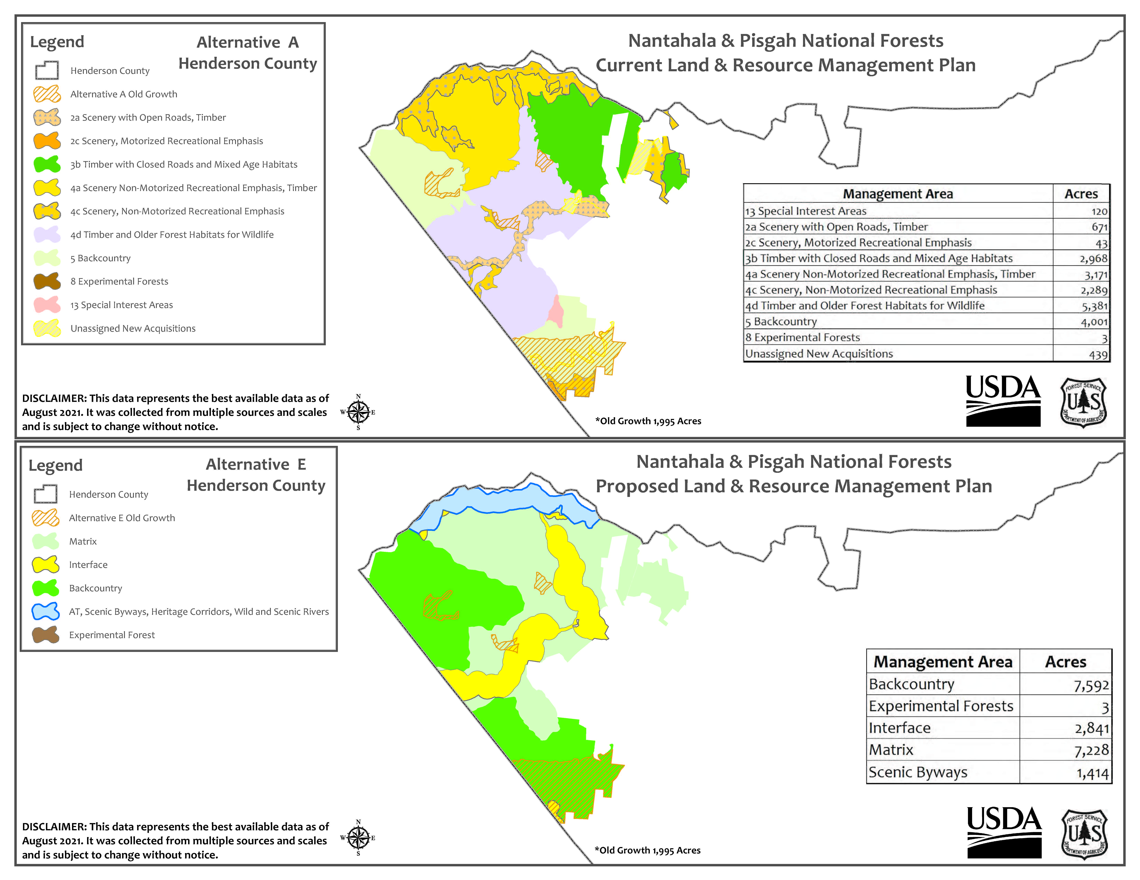

Slide 8
Public Comment
  LDC Text Amendment Discussion

Slide 9
Public Comment
  2045 Comprehensive Plan
  FLU Map Discussion

Slide 10
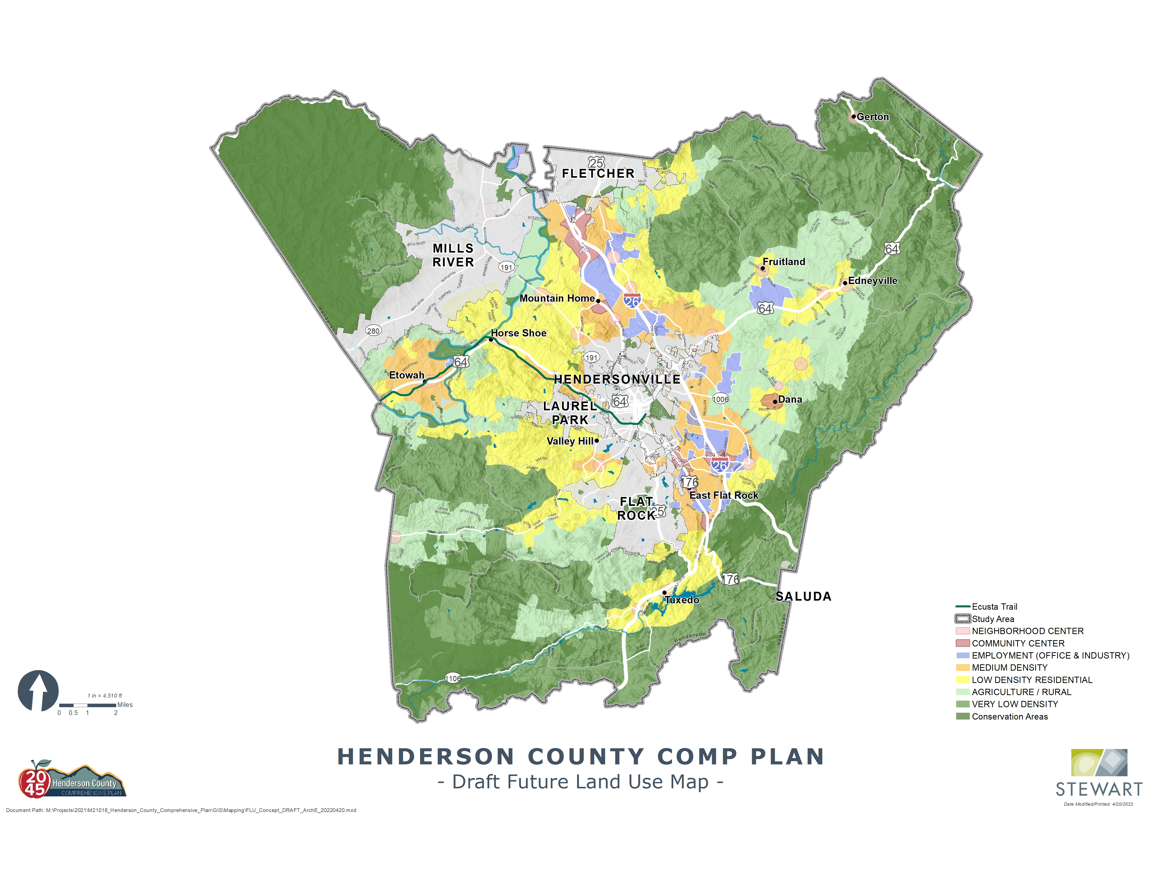

Slide 11
Public Comment
Agenda
Meeting Called to Order
Roll Call
Informal Public Comment
Adjustment of Agenda
March 17, 2022 Meeting Summary
Presentation on the Nantahala/Pisgah Forest Plan – Dave Casey, District Ranger
LDC Text Amendment Continued Discussion
2045 Comprehensive Plan FLU Map Discussion
Staff Updates
Adjournment

