Slide 1
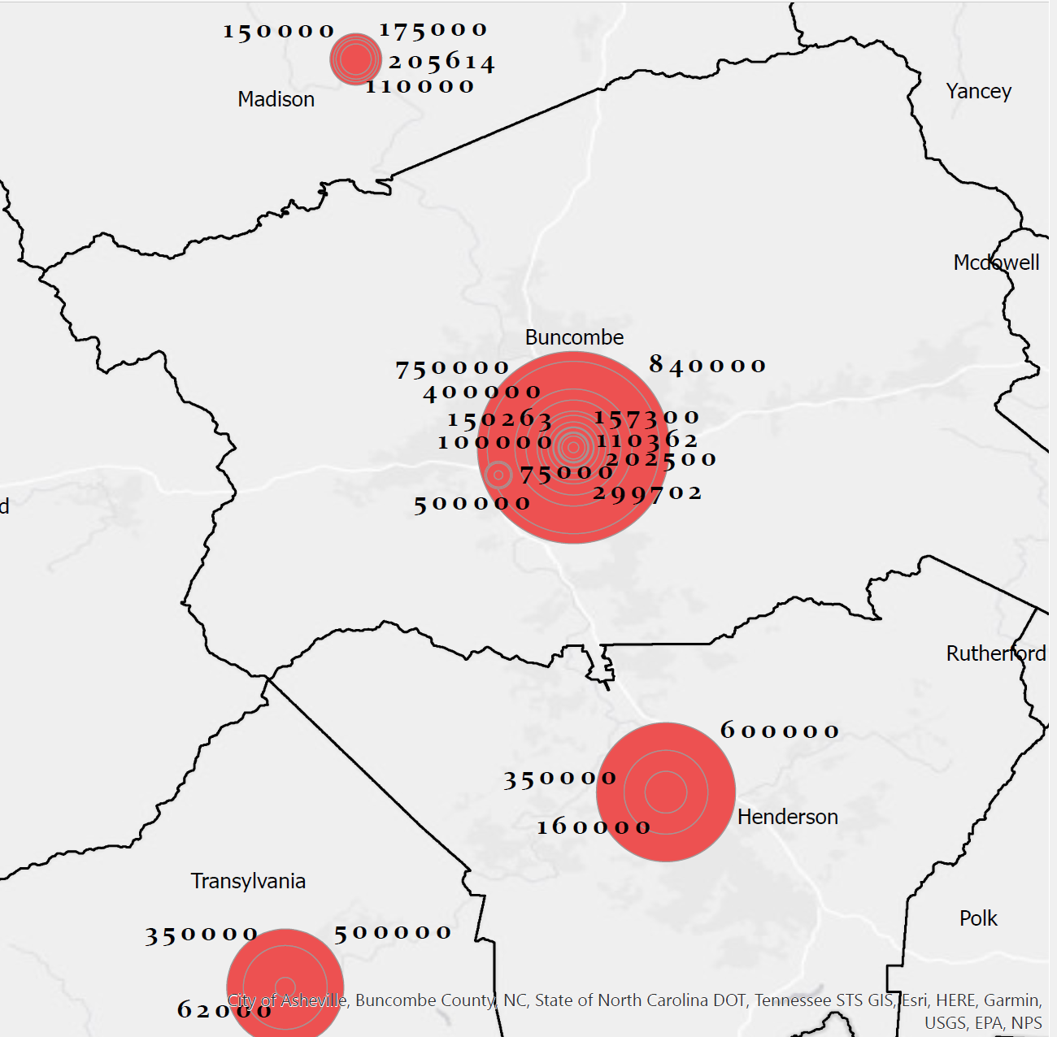
ARHC 2020-2024 Awarded Projects

Slide 2
2020-2024 Allocation of Funds

Slide 3
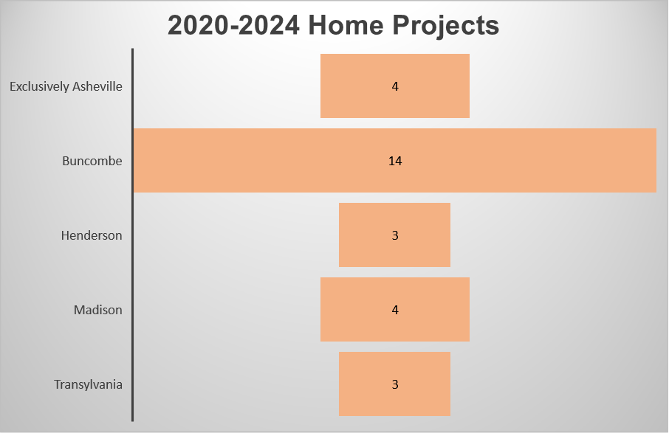
Project Count
*3 of Buncombe's projects overlap with city of AVL

