Slide 1

Henderson County Environmental Advisory Committee Agenda
Thursday, August 6th, 2026 @ 3:00PM
1. Meeting Called to Order
2. Informal Public Comment
3. Approval of Agenda
4. Approval of April Summary
5. New Business
  Welcome new EAC members – Brenda Sauer
  Cancel October 1st meeting
  Schedule Special Meeting for October
  Non-native invasive vegetation strike team
    Guest speaker Steve Pettis - NC Cooperative Extension
6. Older Business
  Recreational Water Quality Monitoring update
7. Environmental Planning Update
  Funding Opportunities Updates
8. Next meeting Topics
9. Adjournment

Slide 2
Public Comment
3
2

Slide 3
Public Comment
2
1

Slide 4
Public Comment
1
0

Slide 5
New Business - Administrative
Welcome new member – Brenda Sauer
Cancel October 1st Meeting
Schedule Special Meeting for October

Slide 6
New Business - NNI
Non-native Invasive Vegetation Strike Team
  Volunteer-based
  Training in invasive vegetation identification and removal
  Collaborate with Parks and Recreation Department
Guest Speaker – Steve Pettis, NC Cooperative Extension Agent

Slide 7
New Business – NNI (cont.)
To do:
  Establish volunteer base
    Supplies (gloves, tools, herbicides, applicators, etc.) depends on number of volunteers
  Determine engagement strategy
  Schedule training session with Steve Pettis
  Establish calendar of workdays at Jackson Park and Ecusta Trail for FY27
    Determine frequency (e.g., monthly, quarterly, etc.)
  Identify partnerships
    Conserving Carolina – Kudzu Warriors
    Mountain True NNIP Program
    Others?

Slide 8
Old Business – Recreational Water Quality Monitoring
Four sites across county
  French Broad at Westfeldt Park
  Cane Creek at Fletcher Park
  Mud Creek at Berkely Road Oklawaha Greenway Access
  Mills River at Mills River Park
6 volunteers, 3 committee members, 1 county employee
Partnerships – Mills River Partnership, NC Department of Environmental Quality, and Sierra Nevada Brewery
9 Sampling events completed – 5 to go!

Slide 9
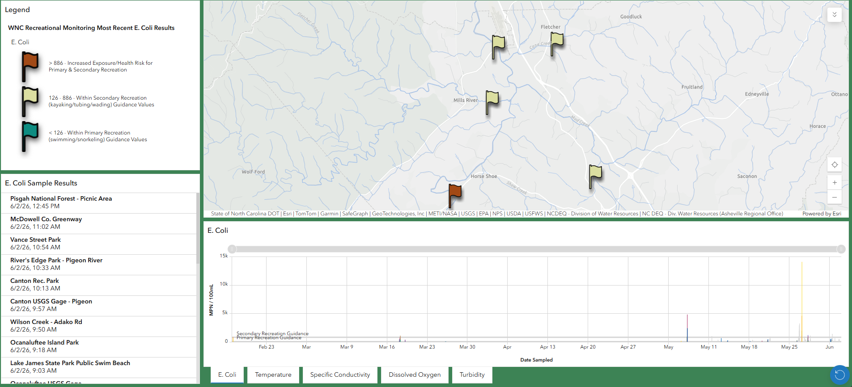
Old Business – Recreational Water Quality Monitoring
View results weekly at SwimGuide.Org or NCDEQ Water Quality Monitoring Dashboard

Slide 10
Environmental Programs Updates
Jackson Park Native Plants for Mosquito Control
  B.W. Wells Stewardship Fund
  Community Foundation of Henderson County
EQI Water Quality Monitoring VWIN program
  Community Foundation of Henderson County

Slide 11
Next Meeting Topics

