Slide 1

Henderson County Environmental Advisory Committee Agenda
Thursday, June 4th, 2026 @ 3:00PM
1. Meeting Called to Order
2. Informal Public Comment
3. Approval of Agenda
4. Approval of April Summary
5. New Business
  Welcome new EAC members – Ryan Romanson and Matthew Berens
  Review EAC member applicants – Brenda Sauer
  Revisit Priority Survey
  Recap of Spring Outreach Events and Volunteer Engagement
  Establishing “Heritage/Champion Tree” program in partnership with the Historic Resources Commission
6. Older Business
  Recreational Water Quality Monitoring update
7. Environmental Programs Update
  Funding Opportunities Updates
  Phoebe Schropp – UNC Asheville MSER Special Project – Natural Capital Assessment of Vacant and Undeveloped Lands in Henderson County
8. Next meeting Topics
9. Adjournment

Slide 2
Public Comment
3
2

Slide 3
Public Comment
2
1

Slide 4
Public Comment
1
0

Slide 5
New Business – Review EAC Applications
Brenda Sauer

Slide 6
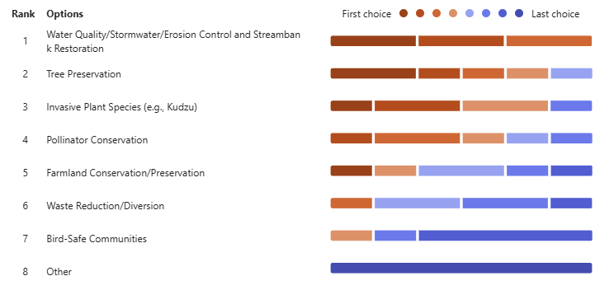
New Business – Revisit Priority Survey
New members completed priority survey

Slide 7
New Business – Spring Outreach Recap
Mills River Earth Festival – April 11th at Mills River Park
Hendo Earth Festival – April 18th in Downtown Hendersonville
Ecusta Market and Café – April 22nd
Mills River Day – May 2nd at North Mills River Farm
Green Drinks Presentation – May 14th at the Local Table
9 Volunteers for general projects

Slide 8
Old Business – Recreational Water Quality Monitoring
Four sites across county
  French Broad at Westfeldt Park
  Cane Creek at Fletcher Park
  Mud Creek at Berkely Road Oklawaha Greenway Access
  Mills River at Mills River Park
6 volunteers, 3 committee members, 1 county employee
New partnerships – Mills River Partnership, NC Department of Environmental Quality, and Sierra Nevada Brewery

Slide 9
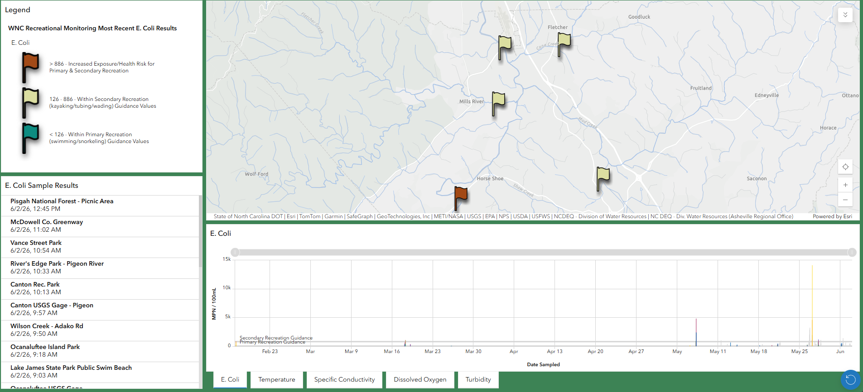
Old Business – Recreational Water Quality Monitoring
View results weekly at SwimGuide.Org or NCDEQ Water Quality Monitoring Dashboard

Slide 10
Environmental Programs Updates
Foam Recycling Grant
  Food Packaging Institute - Foam Recycling Coalition
  Not awarded
EQI Non-profit budget allocation for continuation of VWIN Water Quality Monitoring Program
  Funding decision pending

Slide 11
Environmental Programs Updates
Special Guest Presentation – Phoebe Schropp, UNC Asheville M.S. Environmental Resiliency

Slide 12

Spatial Valuation of Ecosystem Services: Estimating Natural Capital Across Undeveloped Parcels in Henderson County, North Carolina
Phoebe Schropp

Slide 13
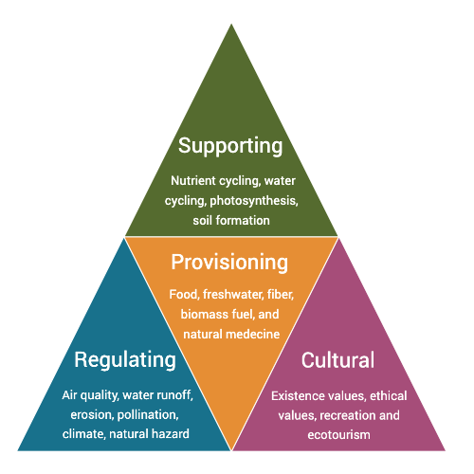
Introduction
Land-use decisions are typically market-driven
Focus on direct financial returns
Non-market benefits (ecosystem services) often overlooked
Leads to undervaluation of natural landscapes

Slide 14

Why It Matters
Climate change → more extreme weather events
Ecosystem services = critical for:
  Community resilience
  Economic stability
Yet rarely included in planning decisions

Slide 15
The Core Problem
Ignoring ecosystem services leads to:
  Degradation of natural capital
  Increased environmental risk
Key gap: value exists, but is not economically visible

Slide 16

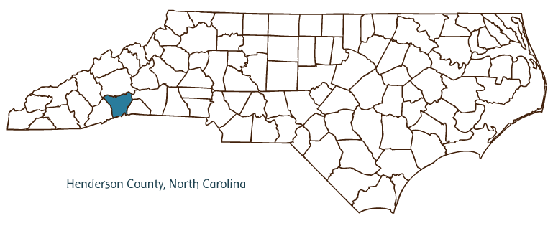
Local Context & Motivation
Henderson County 2045 Comprehensive Plan
Strong public support for:
  Open space protection
  Forest and farmland conservation
But tension between:
  Conservation goals
  Development pressures

Slide 17

Project Purpose
Partner: Henderson County Planning Department
Goal:
  Quantify economic value of undeveloped land
Address disconnect between:
  Environmental value
  Economic decision-making

Slide 18
Research Questions
What is the economic value of natural capital on undeveloped land?
How does vegetation/land cover affect ecosystem service values?

Slide 19
Study Scope
Focus on undeveloped land types:
  Vacant parcels
  Open space / conservation parcels
  Present-Use Value (PUV) parcels
Evaluate multiple ecosystem services at the parcel level

Slide 20
Methods Overview
Approach: Spatial natural capital valuation combining GIS + economic analysis (benefit transfer)
Tools: ArcGIS Pro, ArcGIS Online, QGIS, InVEST
Main Data Sources:
  Parcel & land use data (Henderson County GIS)
  Land cover (NLCD)
  Tree Canopy (Henderson County GIS)
  Soil data (USDA)
  Precipitation (NOAA / RaInDROP)

Slide 21
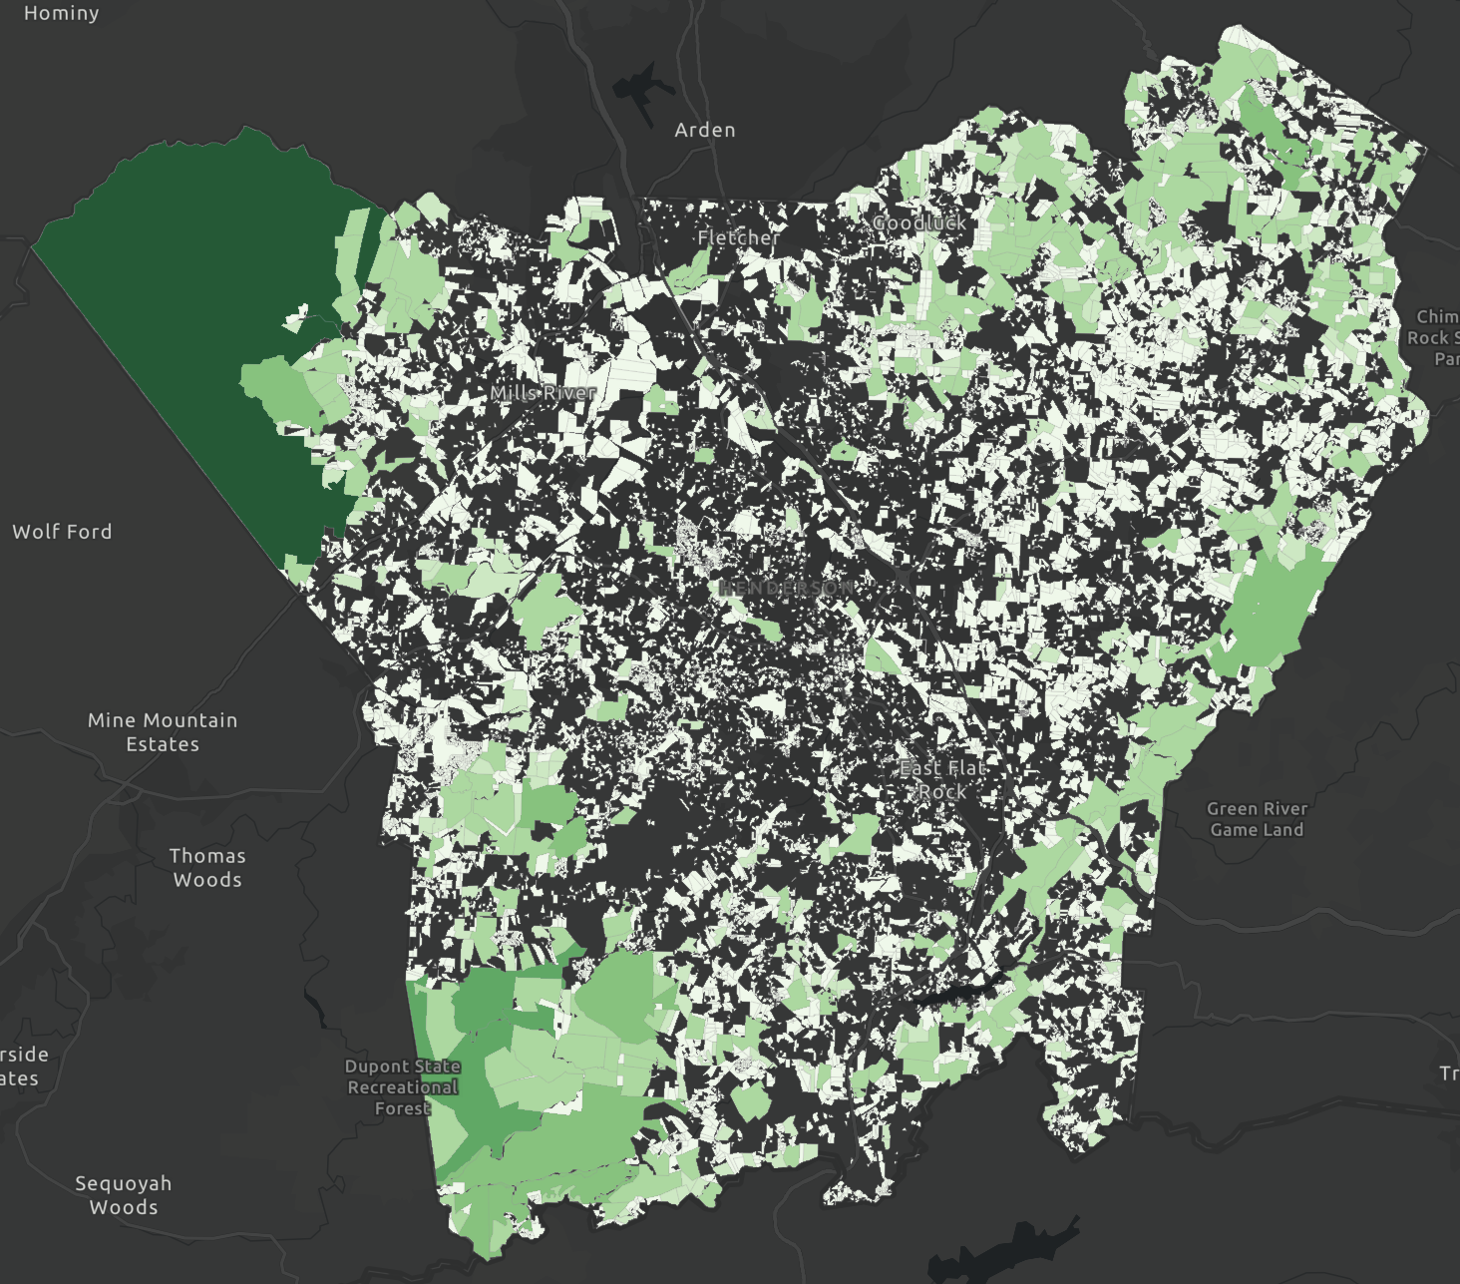
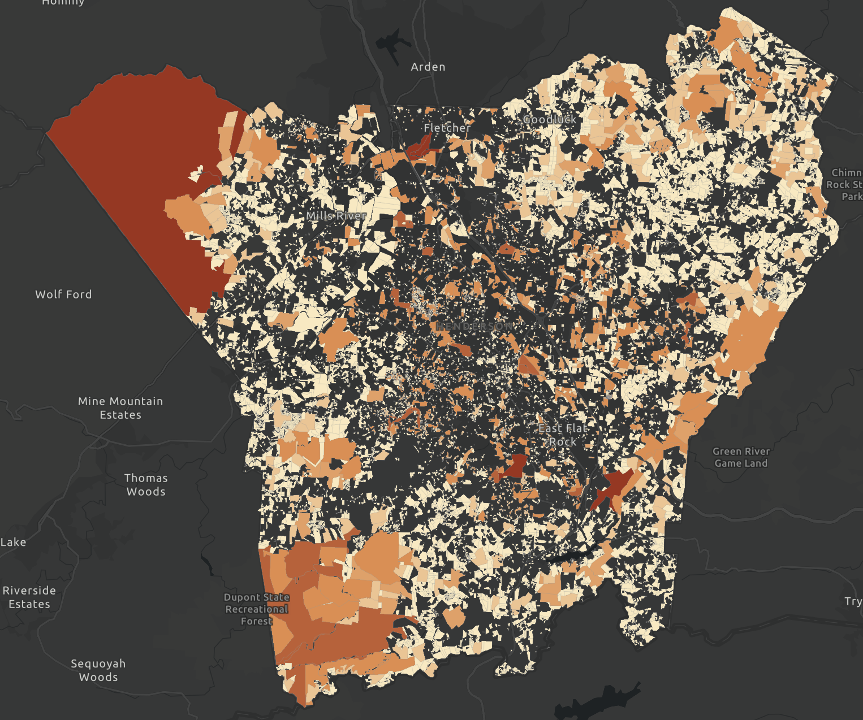
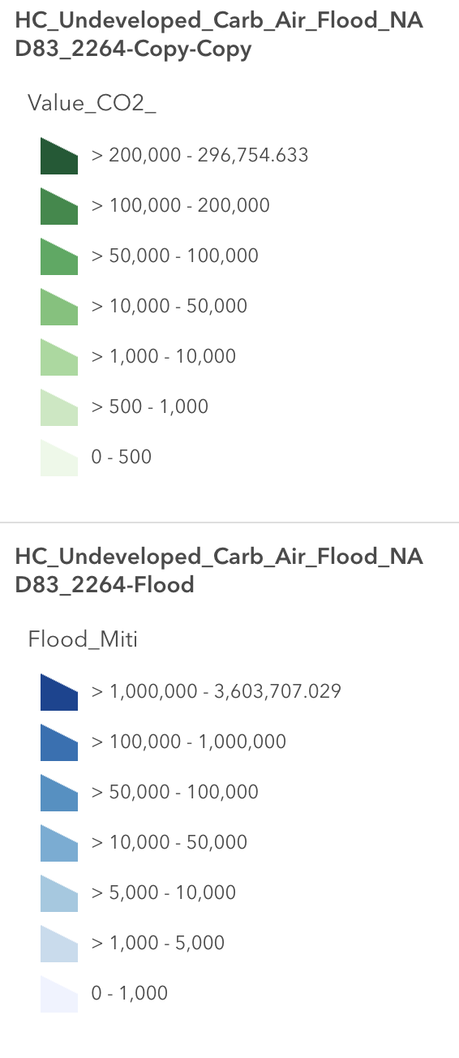
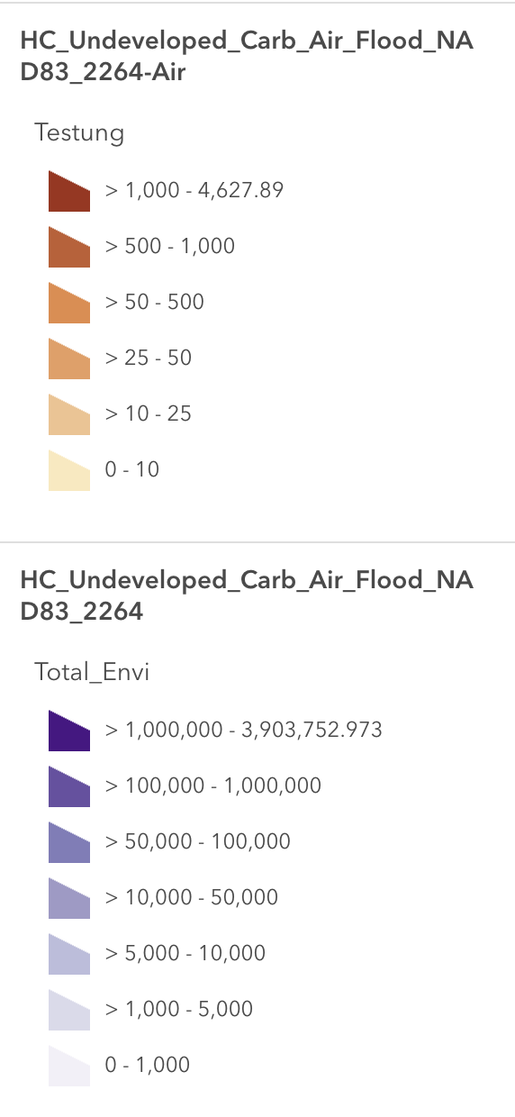
Current Results
Carbon Sequestration Value in 2020 USD
Air Purification/Filtration Value in 2010 USD
Notes:
https://arcg.is/0Wnn9H1

Slide 22
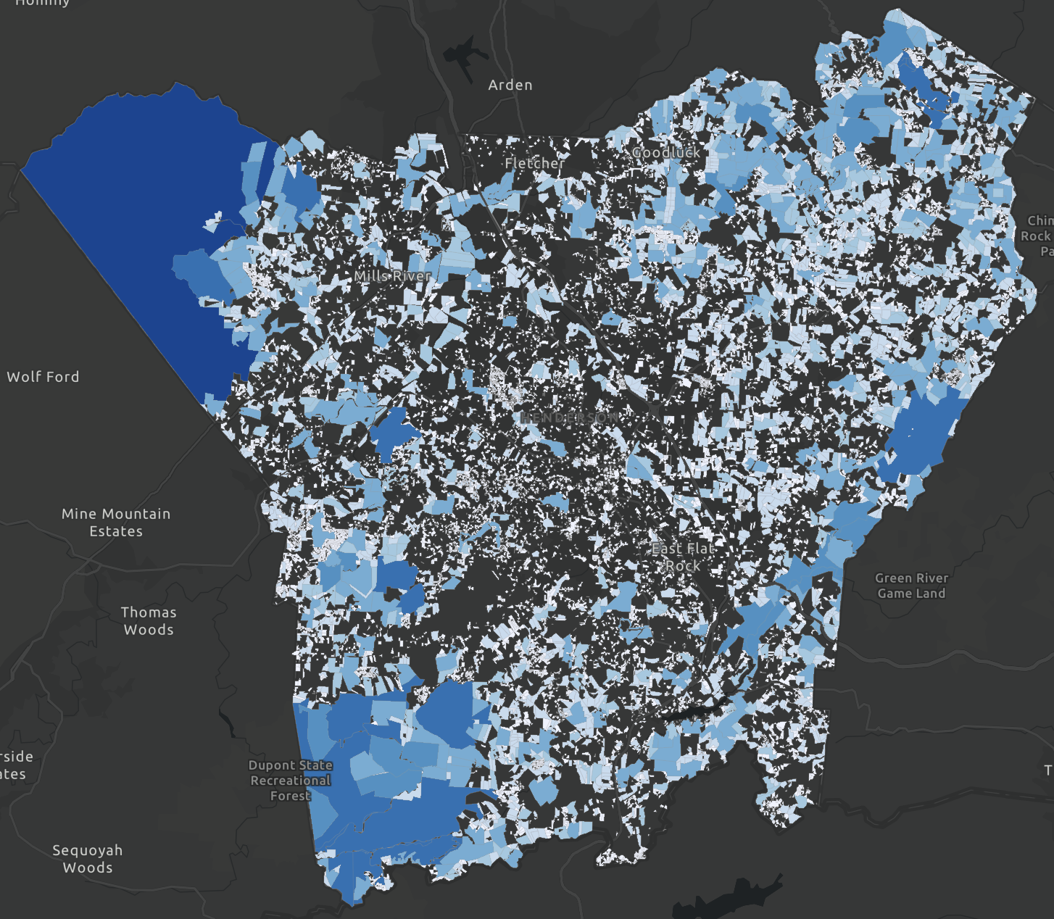
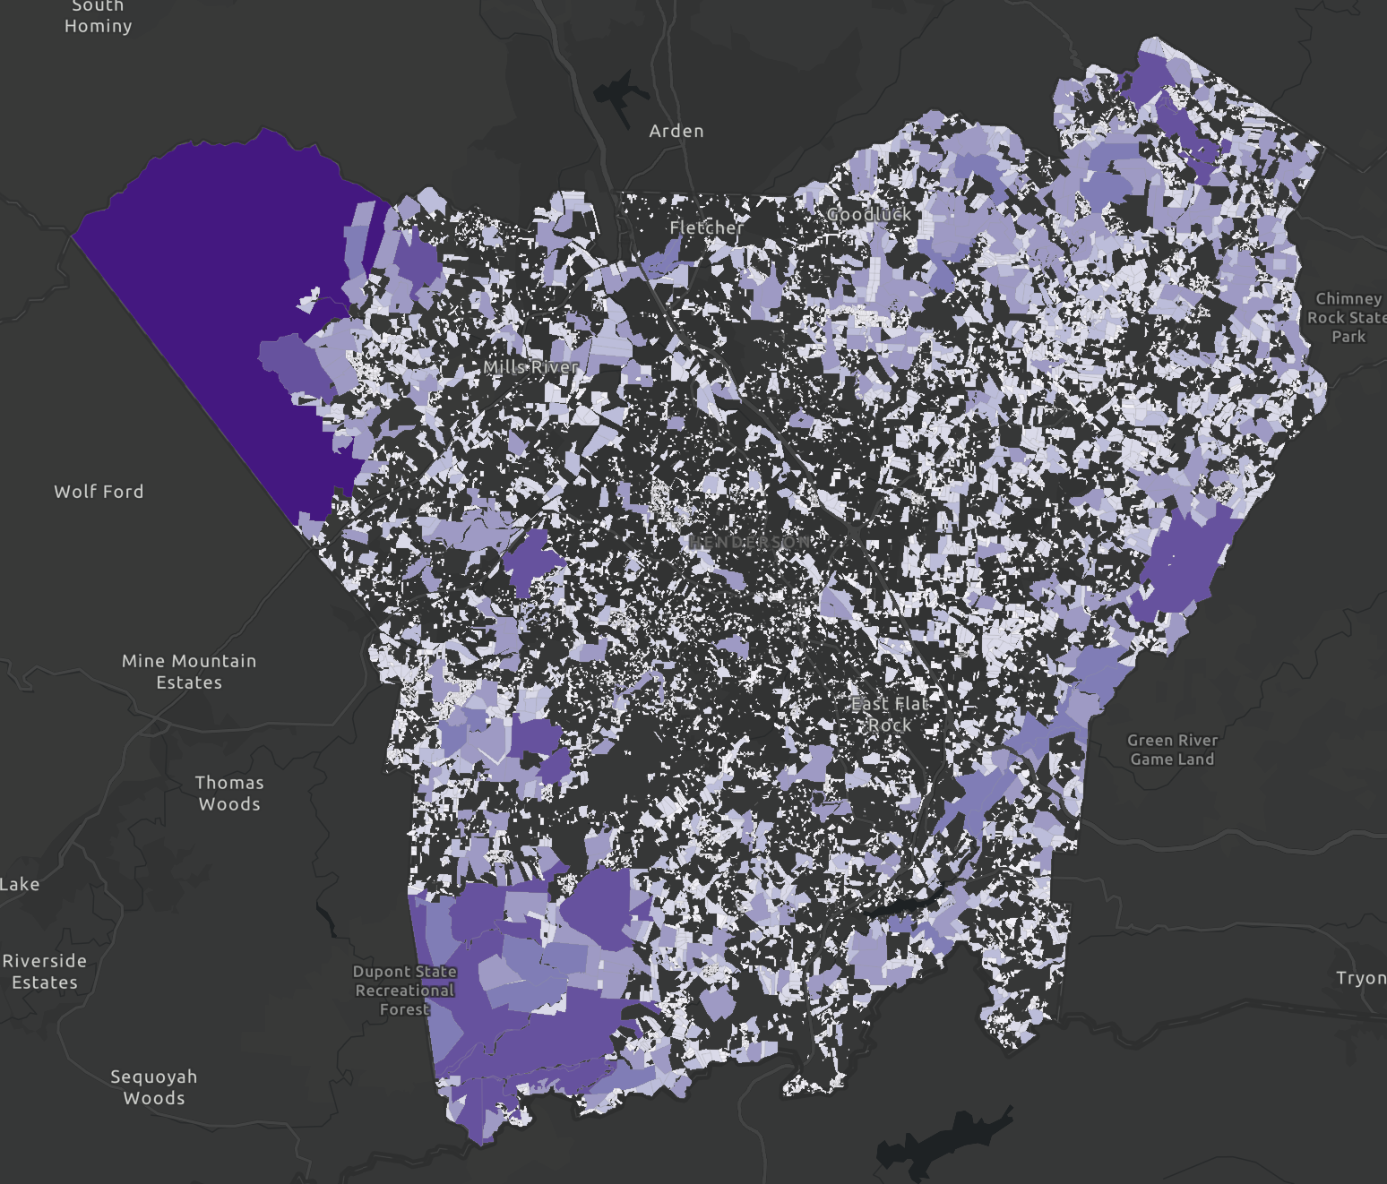
Current Results
Flood Mitigation Value in 2025 USD
Total Ecosystem Services Value in USD
https://arcg.is/0Wnn9H1
Notes:
https://arcg.is/0Wnn9H1

Slide 23
Next Steps
Calculate 1 or 2 more Ecosystem Service Values for each Parcel
Create a public facing dashboard to access this information

Slide 24
Thank You!

Slide 25
Next Meeting Topics

